Slide 1
Generics
Java allows generic classes to use something called a generic type
Added in 1.5, it allows code to be flexible and also type safe
Old version of a list:
public interface OldStyleList {
public boolean add(Object obj);
public Object get(int index);
}
New version of a list:
public interface List<T> {
public boolean add(T obj);
public T get(int index);
}

Slide 2
Generics
Generics allows List<String>, List<Double>, List<AddingMachine> all from one List.java
<T> in the class/interface/method declaration says that the type will be defined (at compile time) by the code that uses a class or method
Callers must specify <String>, <ComputeResult>, etc when they create a variable of that type.
Advanced usage: you can use ? to allow any type or one of several types; ex
List<?> whoCaresWhatsInTheList;

Slide 3

Generics
Generics have some rough edges because they were added in a backwards-compatible way; in particular, the <> type information only exists at compile time, not at runtime, and it is optional even there.
If you write
List<String> strings = new ArrayList<String>();
strings.add("This isn't an integer");
List noTypeSafetyList = strings;
List<Integer> hahaAllTheBugs = noTypeSafetyList;
int x = hahaAllTheBugs.get(0);
it will compile. If you try to run it, it will crash on the last line with a ClassCastException
Less obvious examples will break in a hard to track down way when you run the code by throwing ClassCastExceptions that look like they should be prevented by the Java language spec
⇒ Avoid these bugs by always specifying a type for any class or interface that is generic. If you see a warning about raw types, you need to add a <> type definition to your variable. <?> counts!

Slide 4
Generics (Beyond the Basics)
Very expressive framework
Fills in the missing gap with "ability" interfaces (Closeable, Identifiable, etc).
Ex: A method that takes in a List of Identifiables, and returns a Map from id to object
public interface Identifiable {
long getId();
}
public Map<Long, Identifiable> getIdMap(List<Identifiable> data);

Slide 5
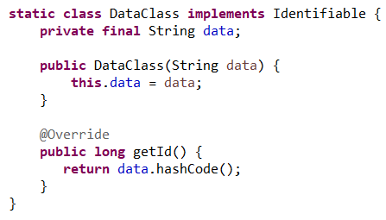

Generics Example
Problem 1: Using the method
The naive approach doesn't compile!
While DataClass is a subtype of Identifiable,
List<DataClass> is not a subtype of List<Identifiable> (for good reason - what could break if it were?)

Slide 6
Generics Example
Solution: Use the extends keyword to define type characteristics
public Map<Long, Identifiable> getIdMap(List<? extends Identifiable> data);

Slide 7
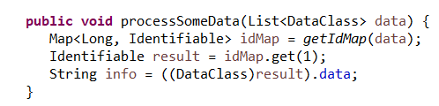
Generics Example
Problem 2: Using the return value
Now it compiles, but getting data from the map requires a cast

Slide 8
Generics Example
Solution: Define a type variable to force type safety between parameters and output
public <T extends Identifiable> Map<Long, T> getIdMap(List<T> data);

Slide 9
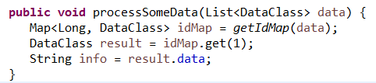
Generics Example
Now the client code looks good!

Slide 10
Creating Easily-Pluggable Libraries
Team/Company #1 creates Library A with some useful interfaces
Team/Company #2 builds on top of Library A with Library B
Team/Company #3 also builds on top of Library A with Library C
Team/Company #4 is using Library B - how can Team #3 make Library C useful in this situation?
Team 4
B
C
A

Slide 11
Generics and Multi-Interface
Ex: Fully reading data from some closeable, identifiable stream
Team 3:
public static <T extends Identifiable & Closeable & Iterable<String>>
List<String> readFully(T inputStream) {
System.out.println("Reading stream: " + inputStream.getId());
List<String> result = new ArrayList<>();
try (inputStream) {
for (String s : inputStream) {
result.add(s);
}
} catch (IOException e) {
System.err.println("Error reading stream: " + inputStream.getId());
}
return result;
}

Slide 12
Generics and Multi-Interface
Team 2:
static class CustomInputStream implements Identifiable, Closeable, Iterable<String> {
private final List<Integer> data;
public CustomInputStream(List<Integer> numbers) {
this.data = numbers;
}
@Override
public long getId() {
return data.hashCode();
}
@Override
public Iterator<String> iterator() {
return data.stream().map(number -> "" + number).iterator();
}
@Override
public void close() throws IOException {
// nothing to do
}
}

Slide 13
Generics and Multi-Interface
Team 4:
public void processSomeData(CustomInputStream stream) {
System.out.println(readFully(stream));
}

Slide 14
Your Turn!
Write a method that computes the length of an Iterable - make it as generic as possible
Add the following interface to your project:
public interface Sizeable {
public int getSize();
}
3. Modify the method to require that the Iterable contain items that are Sizeable, and now compute the total size of everything in the Iterable
4. Verify that your method is easy to use: create a class that implements Sizeable, and check that you can pass a List of that type to your method from (3) (Note: List<T> implements Iterable<T>)

Slide 15
Solution
public class GenericIteratorCounter {
public int countSize(Iterable<? extends Sizeable> input) {
int totalSize = 0;
for (Sizeable value : input) {
totalSize += value.getSize();
}
return totalSize;
}
public static void main(String[] args) {
List<SizeableType> listOfLists = new ArrayList<>();
new GenericIteratorCounter().countSize(listOfLists);
}
public static class SizeableType implements Sizeable {
List<String> list = new ArrayList<>();
@Override
public int getSize() {
return list.size();
}
}
}

Slide 16
Let’s Review
Exceptions:
Three different ways to signal errors to a user: Exception, Error Codes/Return Values, Optional
What each is and when to use them
try/catch/finally - syntax and what each block does
try-with-resources - when to use it, why to use it
Generics:
syntax, including ? and ? extends
How the compiler uses this to enforce type safety
When should you add a type parameter
How to use code that has a type parameter

